Slide 1







01
Combinatorial
Synthesis
Presented by
Mst. Sorme khatun
ID:232211012

Slide 2




02
Introduction of
Combinatorial Synthesis
Combinatorial synthesis is a new method in chemistry.
It is used to make many compounds fast.
Small chemical parts are mixed in many ways to make new compounds.
It helps scientists to find new medicines quickly.
It also saves time and money.

Slide 3
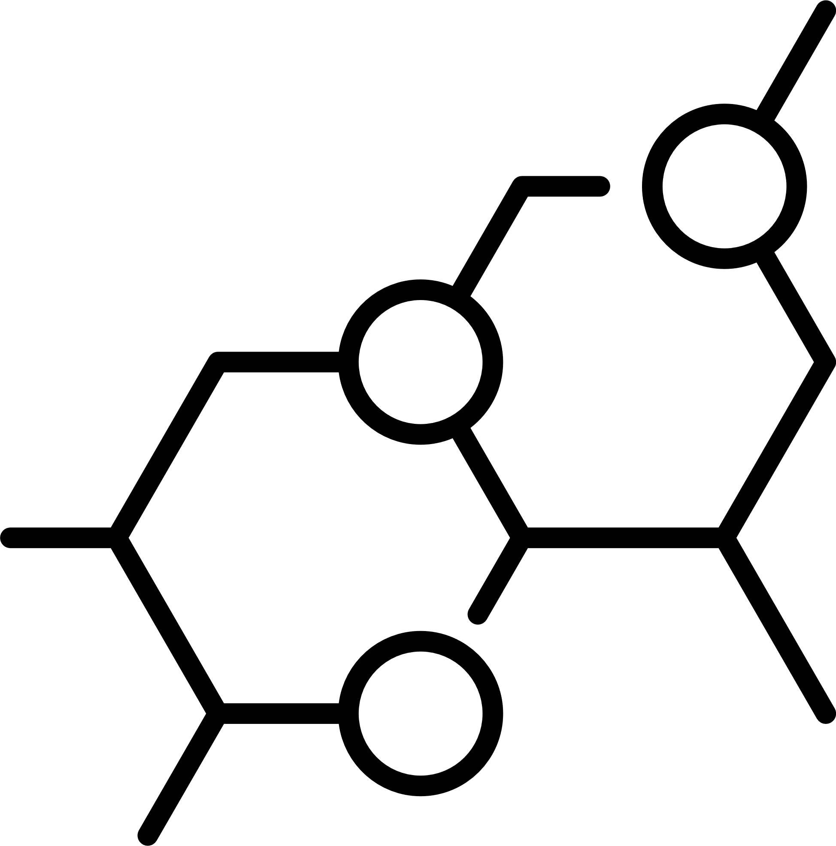



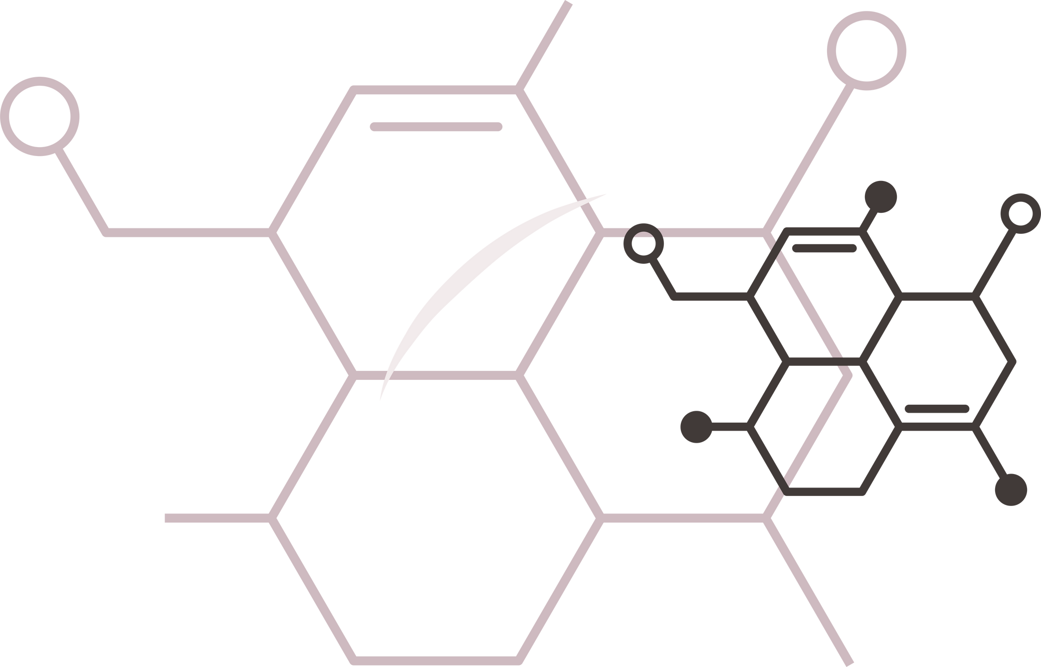

03
Principle of
Joining Chemical Parts
Small chemical parts are joined in many ways to make many new compounds.
Combinatorial Synthesis
Simultaneous Creation
These compounds are made at the same time (not one by one).
Finding Active Compounds
The aim is to find a useful or active compound (like a good medicine).
Compound Library
All the new compounds are kept in a compound library for testing.

Slide 4




04
Application of
Combinatorial Synthesis
Drug discovery – Used to make and test many compounds to find new medicines.
Pharmaceutical industry – Helps in making new drugs faster and cheaper.
Material science – Used to make new materials with special uses.
Chemical research – Helps scientists study many compounds at one time.
Biotechnology – Used to find new active compounds for enzymes and proteins.

Slide 5

05
Advantages
Hanover
and Tyke
1. Makes many compounds fast.
2. Saves time and money.
3. Helps in finding new drugs quickly.
4. Can be done by machines (automation).
5. Makes a large compound library for testing.

Slide 6
06
Disadvantages
Hanover
and Tyke
1. Some compounds may be inactive or useless.
2. Purity of compounds may be low.
3. Needs advanced machines and tools.
4. Data handling is difficult (too many compounds).
5. Some reactions may not work well for all compounds.

Slide 7




07
Thank you

